Slide 1
House Price Prediction Project
Final Project – Group 2
Group members:
Nevyn Brown
Priya Sivaraj
Ros Tiamzon

Slide 2
TABLE OF CONTENTS
01
02
03
HOUSE PRICE PREDICTION PROJECT GOAL
MODELS. TECHNOLOGIES, LIBRARIES
DATA PREPARATION, EXPLORATION, CLEANING, FEATURE ENGINEERING
04
05
06
NEXT STEPS
MODEL TRAINING, TESTING AND FINE TUNING
ACHIEVING PROJECT GOAL, RESULTS & CONCLUSIONS

Slide 3
PROJECT GOAL
“Our aim is to create a predictive analysis of house prices so we can advise potential buyers or investors on sales prices and where to buy (neighborhood) based on the home features that they value most”
- Group 2
HOUSE
PRICE PREDICTION

Slide 4
MODELS, TECHNOLOGIES AND LIBRARIES
numpy
Pandas
seaborn,
sklearn
xgboost
pickle
matplotlib, hvplot,
numpy: provides comprehensive mathematical functions, used for working with arrays.
pandas: provides a plethora of useful functions that make it easy to express, analyze, and manipulate data.
matplotlib: a comprehensive library for creating static, animated, and interactive visualizations in python.
hvplot: allows for users to easily generate a wide array of plot types and interactive visualizations
seaborn: a library mostly used for statistical plotting in Python, built on top of matplotlib and provides beautiful default styles and color palettes to make statistical plots more attractive.
sklearn: a machine learning library for the python programming language that allows for the use of multiple machine learning models, tools, and algorithms.
xgboost: is an implementation of gradient-boosting decision trees. It has been used by data scientists and researchers worldwide to optimize their machine-learning models.
pickle: used in serializing and deserializing a Python object structure.

Slide 5
DATA PROCESSING
STEP 1: DATA COLLECTION
Collected public information on housing data
STEP 2: DATA EXPLORATION
Analyzed data, house features, correlation of house features to sales prices, analyzed numerical variables (discrete vs continuous), analyzed categorical features, distribution of sales prices
STEP 3: DATA CLEANING
Analyzed/cleansed missing data, analyzed outliers
STEP 4: HOME FEATURES ENGINEERING
STEP 5: DATA TRANSFORMATION
Analyzed rare categorical features (less than 1% removed since not adding value to sales price)
Converted categorical variables to one hot encoding, removed duplicates, prepared data for feeding into the model

Slide 6
MODEL TRAINING, TESTING AND FINE TUNNING
#3
#2
#1
FINE TUNNING
EVALUATING RMSE
XGBOOST

Slide 7
Relevant House Features Used
Sales Price - the property's sale price in dollars. This is the target variable to be predicted.
MS Zoning: The general zoning classification
Lot Area: Lot size in square feet
LotFrontage: Linear feet of street connected to property
LandContour: Flatness of the property
Utilities: Type of utilities available
Neighborhood: Physical locations within Ames city limits
Condition1: Proximity to main road or railroad
BldgType: Type of dwelling
HouseStyle: Style of dwelling
OverallQual: Overall material and finish quality
OverallCond: Overall condition rating
YearBuilt: Original construction date
YearRemodAdd: Remodel date
Exterior1st: Exterior covering on house
TotalBsmtSF: Total square feet of basement area
CentralAir: Central air conditioning
FullBath: Full bathrooms above grade
HalfBath: Half baths above grade Bedroom: Number of bedrooms above basement level
Kitchen: Number of kitchens
KitchenQual: Kitchen quality
Fireplaces: Number of fireplaces
GarageArea: Size of garage in square feet
GarageCars: Size of garage in car capacity
GrLivArea: Above grade (ground) living area square feet
PavedDrive: Paved driveway
PoolArea: Pool area in square feet
TotRmsAbvGrd: Total rooms above grade (does not include bathrooms)
YrSold: Year Sold

Slide 8
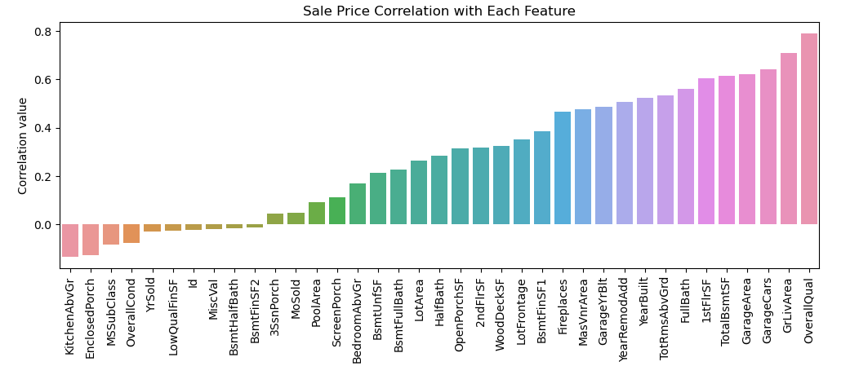
ACHIEVING PROJECT GOAL, RESULTS & CONCLUSIONS

Slide 9
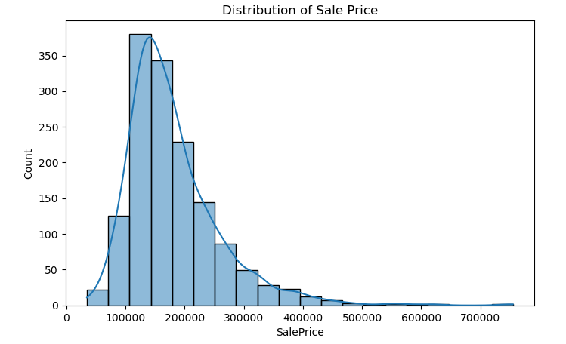
ACHIEVING PROJECT GOAL, RESULTS & CONCLUSIONS

Slide 10
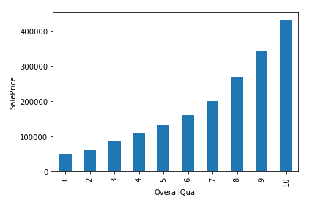
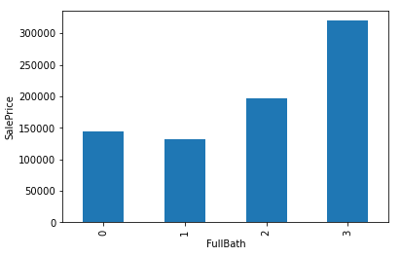
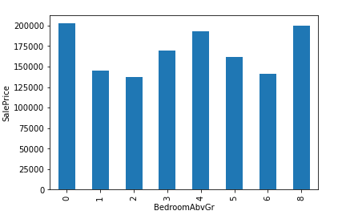
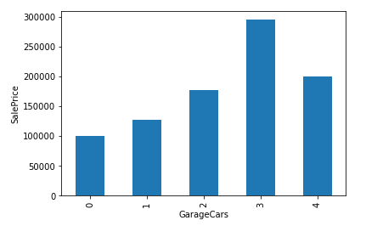
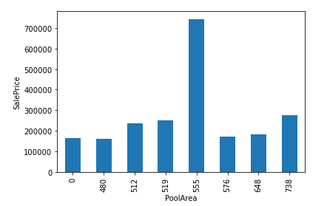
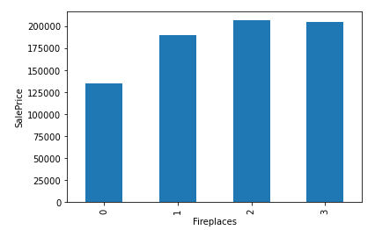
ACHIEVING PROJECT GOAL, RESULTS & CONCLUSIONS
House Feature Correlation to Sales Prices – Discrete variable A discrete variable can only have a set of particular values. Only certain values are allowed, and none of the between values are. Discrete variables cover things that can be counted.

Slide 11
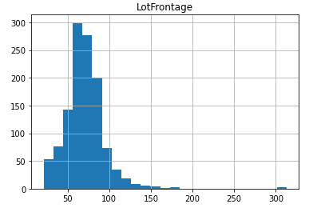
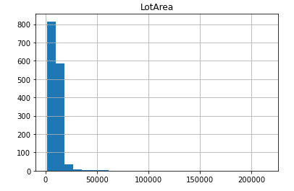
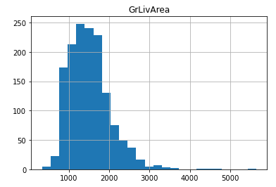
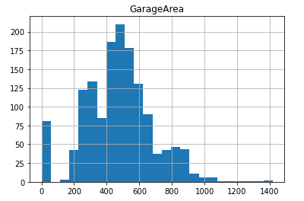
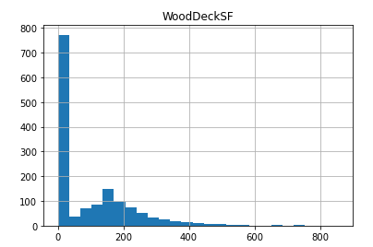
ACHIEVING PROJECT GOAL, RESULTS & CONCLUSIONS
House Feature Correlation to Sales Prices – Continuous variable - A continuous variable can be any value in a range. Usually, things that we are measuring are continuous variables, because it can be any value. A continuous value can have an upper and lower bound, but it can be any value in the range.

Slide 12
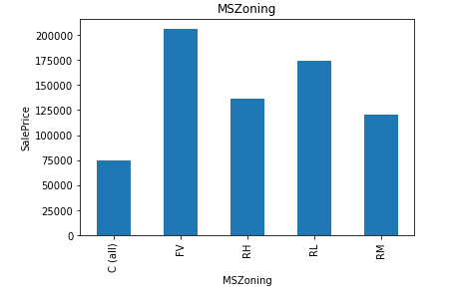
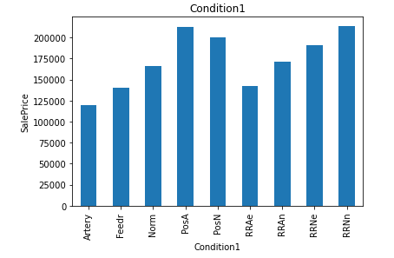
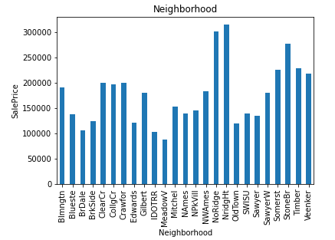
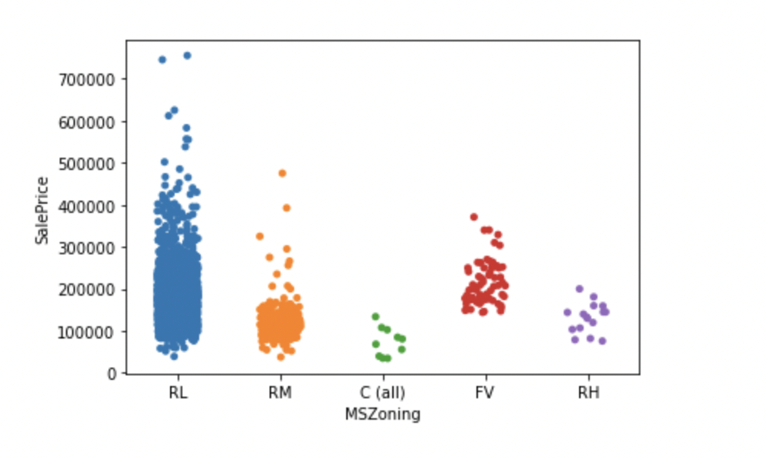
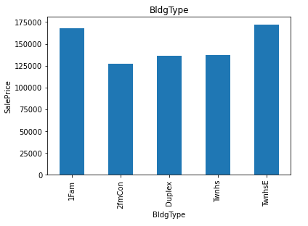
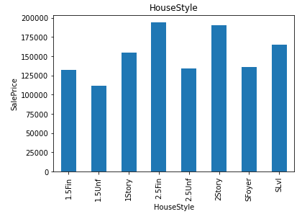
ACHIEVING PROJECT GOAL, RESULTS & CONCLUSIONS
House Feature Correlation to Sales Prices – Categorical variable - Categorical variables are descriptive and not numerical. So any way to describe something is a categorical variable. Hair color, gum flavor, dog breed, and cloud type are all categorical variables.

Slide 13
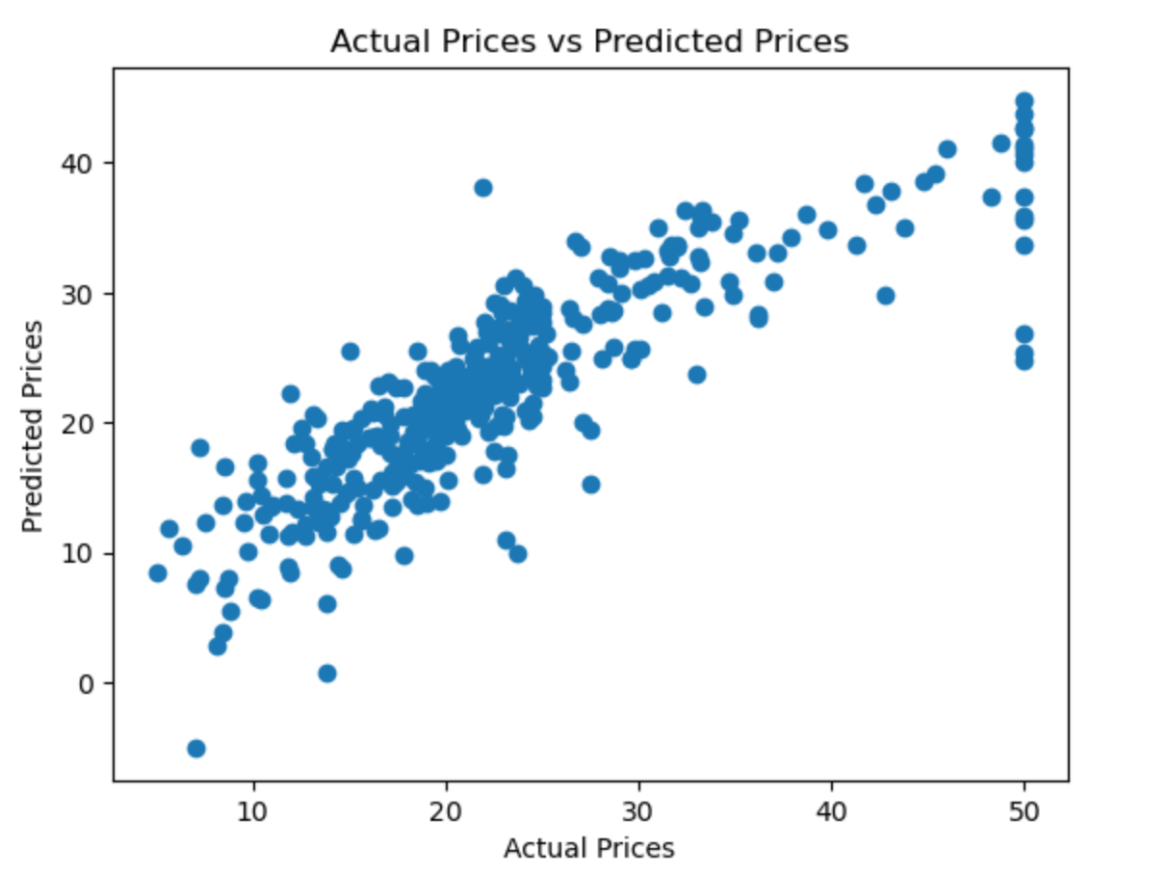
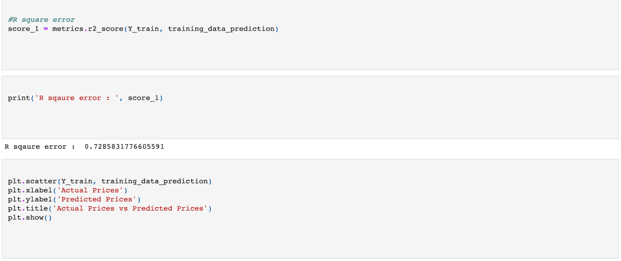
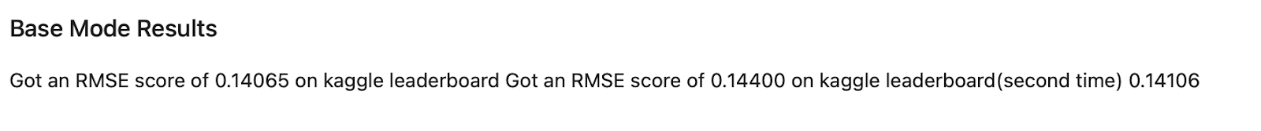
ACHIEVING PROJECT GOAL, RESULTS & CONCLUSIONS
Model Training Results
RMSE is a weighted measure of model accuracy given on the same scale as the prediction target. Simply put, RMSE can be interpreted as the average error that the model’s predictions have in comparison with the actual, with extra weight added to larger prediction errors. Based on a rule of thumb, it can be said that RMSE values between 0.2 and 0.5 shows that the model can relatively predict the data accurately.

Slide 14
ACHIEVING PROJECT GOAL, RESULTS & CONCLUSIONS
House Prediction Analysis for Buyers – Investor questions
Which neighborhood has the highest predicted value of homes? Potentially a good investment.
NRidgHt
How much is the home value ranges in NRidgHT?
$154k - $612k
If overall quality of the house is the most important aspect for a buyer, how much is the range of predicted house prices?
$160k - $625k

Slide 15
WHAT’S NEXT?
If we had more time for the project ………….
We would obtain rental fee information and compare whether it is best to buy or rent.
or
Using predicted values for sales price or rental income, decide which house type, neighborhood, etc will earn the most income for the next 5 – 10 years.
02
01
03
Set up a model where investors can be flagged when it is best to buy a property and when it is best to sell to maximize profit (trigger buy/sell), for investors who buy/sell frequently.
We would set up a user interface (buyer/investor) where buyer can choose set of features or preferences and the model will predict the sale price of the home with specific multiple features, weighted based on what’s important to the buyer.

Slide 16
THANKS
Does anyone have any questions?

